Slide 1
Theory

Slide 2
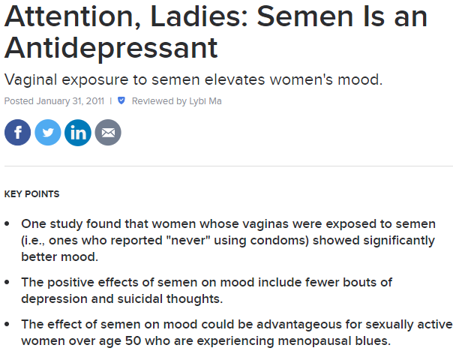
Is sperm an anti-depressant?
https://www.psychologytoday.com/us/blog/all-about-sex/201101/attention-ladies-semen-is-antidepressant
https://pubmed.ncbi.nlm.nih.gov/12049024/

Slide 3
Does picking your nose increase the risk of dementia?

Slide 4
What is a theory?
Explain how variables relate to each other
Multiple variables
Multiple hypotheses

Slide 5
What do theories do?
Classify/describe things
Predict
Explain
Guide research

Slide 6
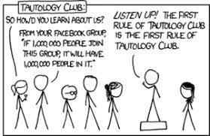
Characteristics of scientific knowledge/theories
Empirical
Rational
Testable (falsifiable; avoid tautologies)
Parsimonious
General
Tentative
Rigorously (and publically) evaluated

Slide 7
Example of how theories grow
Bystander intervention
Initial research
Diffusion of responsibility
Test in other situations
Social impact theory
Add other factors

Slide 8
Scientific explanations
Data
Theory
Deduction
Induction

Slide 9
Intervening variables
Concepts that link the IV and DV
Mediator—accounts for the relationship between the IV and DV; tells “why”
Moderator—affects the direction or strength of the relationship: tells “when” or “how”
Teenagers
Free pizza
Positive morale
Greater productivity
Free pizza
Greater productivity

Slide 10
For each, identify the mediator or moderator and say which it is
1. A study finds that convicted criminals are more likely than noncriminals to score low (negatively) on the Attitudes toward Women Scale. Further research shows, however, that this is only true for violent criminals. There is no relationship between nonviolent criminal activity and negative attitudes toward women.
2. A researcher finds that by increasing self-focus in children, she can decrease their likelihood of cheating on a test. By decreasing cheating, in turn, she finds that academic self-efficacy increases.
3. Dr. Laylor finds a relationship between physical attractiveness and self-confidence. He later determines that the primary cause of this relationship is the positive feedback physically attractive people receive from others.
4. Boys who are popular with other boys tend to also be popular with girls, whereas girls who are popular with the girls tend to be less popular with boys.
5. Researchers found that people who had more contact with Syrian refugees reported less prejudice toward the group. Part of the reason why was that people who had more contact tended to see the group as less threatening.
6. When adjusting for age, gender, and nation-level economic development, researchers found that hedonism, which they defined as valuing pleasure, was more related to reported happiness in individualist countries than in collectivist countries.

