Slide 1
Understanding research articles

Slide 2
https://doi.org/10.1017/S1368980022001586

Slide 3
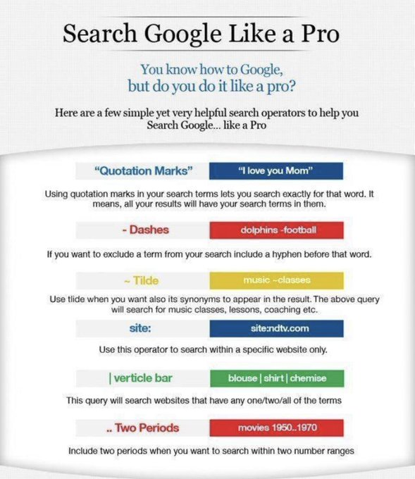

Slide 4
Type of articles
Other things to consider:
Journal quality
Year
Type | Peer-reviewed | Describes original study | Reviews research on an area
Theoretical article
Review article
Meta-analysis
Empirical article
Secondary sources
Primary sources

Slide 5
Parts of an empirical article
https://ojdla.com/archive/winter224/hartonaladiagordon224.pdf
Parts | What it contains | What to use it for
Abstract | Summary | To know whether to read further
Introduction/Lit review | Background/purpose | To find other sources To understand reasoning behind hypothesis
Method (Participant and Procedure subsections) | Study method | To identify potential problems (e.g., confounds, operational definitions) To get ideas for methodology
Results | Study results | To know what they found
Discussion | Explanation and implications of results | To get ideas for future research
Mainly focus on these

Slide 6
What to take notes on when reading articles for your paper

Slide 7
APA 7 style references in text
(Lastname, yr)
(Lastname & Lastname, yr)
(Lastname et al., yr)
(Alphabetical, yr; Lastname, yr)

Slide 8
APA 7 style references in reference section
https://apastyle.apa.org/instructional-aids/reference-guide.pdf
Alphabetical order
Double spaced
Hanging indents
Crossref.org (search metadata for doi)

Slide 9
Your turn

Slide 10
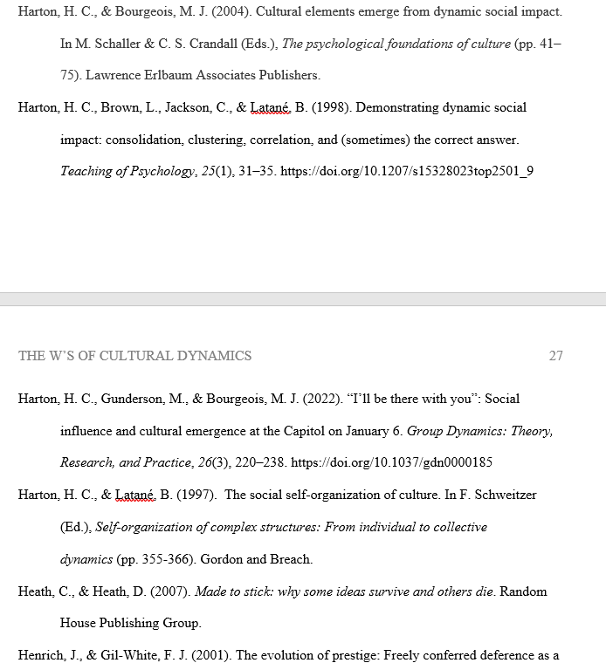

Slide 11
Titles of tables and graphs
DV as a function of IV
DV by IV
The effects of IV on the DV

