Slide 1
Scientific method, hypotheses, and operational definitions

Slide 2
IV, DV, CV review
IV=amount of drug (0, 50mg, 100mg)
DV=improvement in symptoms
CV=all diagnosed with depression
COV=age, weight, ethnicity
CG=the people who don’t get the
drug
Independent variable—cause or “cause”
Dependent variable—what is measured; effect or outcome
Some studies may only have DVs!
Control variable (constant)—something that is the same for everyone in the study
Covariate (extraneous variable)—something you “take out the effects of” in statistical analyses
There are also control groups—comparison group nothing happens to

Slide 3
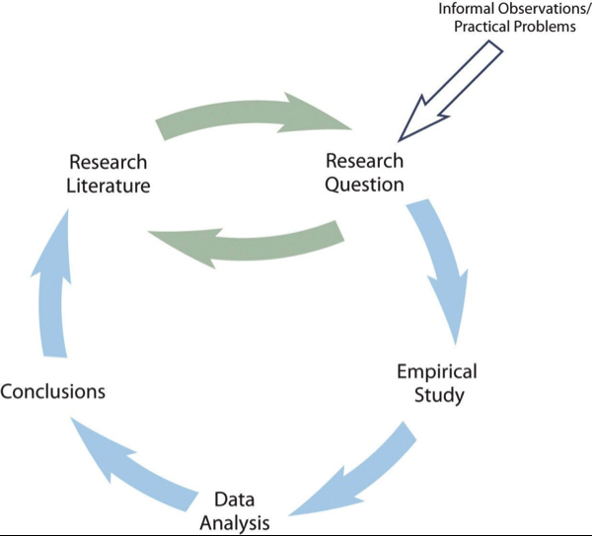
Scientific method
From Price et al., 2017

Slide 4
Step 1 in the scientific method
Formulate testable hypotheses
Can come from:
Practical problems
Personal observation
Theory
Previous research
Empirical articles
Peer-reviewed
This Photo by Unknown Author is licensed under CC BY-NC

Slide 5
What makes a good hypothesis?
1. Specifies relationship between variables
2. Specifies variables in a measurable way (operational definition)
Operational definition= how you produce and measure a construct
Why do they matter?

Slide 6
Are these testable hypotheses?
1. Children whose parents are narcissists will have trouble in school.
2. People who are satisfied with their jobs are happy.
3. Clients with depression tend to feel sad.
4. People who are similar will like each other more.
5. People who are smarter curse more.
6. People from different regions of the country have different personalities.
Measurable?
Specific comparison?

