Slide 1
Advantages and Disadvantages of Experiments
Notes:
Add more on validities, between vs. within

Slide 2
Your ‘Drunk Self’ May Actually be the Real You, According to Scientists
How different is your drunk self and your sober self? The answer might surprise you.
The way that people behave under the influence of alcohol is often believed to be a totally different version of their character. After all, how many people have looked back at their antics the night before and swore that they would have never behaved in such a way if it wasn’t for the demon drink? However, this accepted wisdom may be completely wrong. According to a new study, the way that a person behaves when they are drunk may be closer to the ‘real’ version of themselves than the sober one.
Notes:
Any things that might make you suspicious here?

Slide 3
156 volunteer participants completed personality surveys of their typical drunk and sober personalities two weeks prior to coming to the lab with 2-3 same-sex friends
Randomly assigned to 2 groups and told which it was – one group was given vodka and Sprite and the other group was just given Sprite. Those who were drinking alcohol were told to keep drinking continuously for 15 minutes while they did tasks with their friends.
The participants were asked to rate themselves after completing some tasks with a friend. They were also observed and rated by observers.
Notes:
True experiment?
IV?
DV?
CV?
Problem/confound?
Observers expectations?
Alcohol told to drink continuously
Placebo effect—were they blind to what they were drinking
What were the tasks
Findings don’t fit the setup
*what was IV? DV? Ratings?

Slide 4
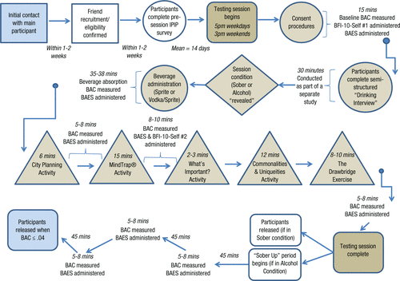
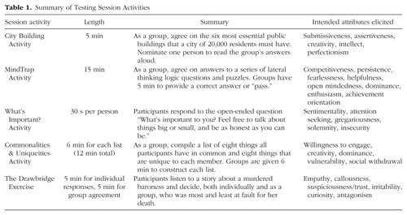
Look at the article
https://journals.sagepub.com/doi/full/10.1177/2167702616689780
Notes:
Go to group sessions—matched on gender, session, day of week, and number of people. 5pm on weekdays or 3pm on weekends
Beverage admin—told they were in the alcohol or sober condition
15 minutes to drink, then did 5 activities with their friends.
Completed a measure of their personality after each task (BAC around .09)
Raters watched think slide, drink clip (?) and full session – 7 raters
Those in alcohol condition reported less open, neuro, and cons and more extraversion than sober on self-reports
On observer reports, only difference was in extraversion

Slide 5
Winograd et al., 2017
Notes:
Said more extraverted, less agreeable and conscientious, more neurotic, and less open when drunk
Raters found more extraverted, but no other differences. *Why? can you see conscientiousness or openness?
Come back to conclusion—what is problem?
Can you “see” neuro or even consciousness?
Doesn’t say anything about whether your drunk personality is your real one!

Slide 6
Advantages/disadvantages of experiments
What can experiments tell you that other studies can’t?
How does the validity of experiments differ from those of surveys and observations?
What practical differences are there in who/what you can study?
Notes:
control,
causality,
High internal validity
Less external validity
may not be real world (but field experiments, combine methods)
may be impossible for some variables.
reactivity

Slide 7
Disadvantages of experiments
Reactivity
Experimenter bias
Validity
Can’t always manipulate your IV of interest

Slide 8
Types of reactivity
Hawthorne effects
Demand characteristics
Placebo effect
Social desirability
Notes:
*how do these show up in study?
1. Hawthorne effect—behavior affected by knowledge that in an experiment
Named after Western Electric Company plant at which an experiment was conducted in the 60’s on factors affecting worker productivity. Six women workers, what affected how fast they could assemble telephone relays. Baseline, then special room with different manipulations—rest pauses, more pauses, payment, lunch, light, etc.
2. Demand characteristics—any feature of study that might inform participants about the purpose of the study
people generally want to be cooperative and will give you what you want
*examples
even if they are wrong, it may affect things
3. placebo effect—in drug studies, may have effect just because they think it will. So give placebo, or inert substance.

Slide 9
Ways to reduce reactivity
Notes:
*get in groups and come up with a list of this or ways to reduce experimenter bias or increase external validity (6 groups)
field experiments, observations (can’t react if don’t know in study)
deception
disguise DV by using filler items or physiological measures
having adequate controls
keep participants blind to hypothesis
simulated experiment—do people report would do what people actually do?
Reduce social desirability
Make more anonymous
ask them at debriefing what they thought study was about

Slide 10
Ways to reduce experimenter bias
Experimenter expectancy effects (self-fulfilling prophesy)
Notes:
6. Experimenter bias—experimenter may act differently toward people in different conditions
7. Ways to get around
train experimenter
run all conditions together
automate the study
double blind study.

Slide 11
Ways to increase external validity
Notes:
Make more real world
Do with the sample you’re interested in
Repeat with other groups/measures (conceptual replication)

Slide 12
Within vs between designs
What is a within vs. between vs. mixed design?
What are the advantages/disadvantages of each?

Slide 13
Study example (IV; DV; CV; within, between or mixed; possible confound; reactivity; experimenter bias; n to have 10 per condition)
Dr. Paper is interested in how paper color affects readability and whether this differs for older vs. younger people. He has people either aged 16-20 or aged 55-65 read three paragraphs from Les Miserables--the first one is printed on red paper, the second one on blue paper, and last one on white paper. All fonts are black and Times New Roman. He then tests recall with 3 questions based on each paragraph.
Notes:
IV—age, color of paper
True experiment?
DV--recall
CV—font, font color
Within, between, or mixed
Possible confounds—order, so counterbalance. Also confound of particular paragraph and color
Reactivity?
Experimenter bias?
How many people do you need to have 50 in each group?
hypothesis

