Slide 1
Correlations

Slide 2
Correlational studies
What is a correlation?
r, Pearson’s r
Magnitude vs. sign vs. significance
Negative vs. positive correlation

Slide 3
Example
 | Height | Weight | Age | Class
Annie | 5’ | 105 | 28 | 4
Bob | 6’ | 220 | 21 | 4
Callie | 5’4” | 136 | 25 | 4
Doug | 5’8” | 168 | 23 | 4
Evan | 5’9” | 150 | 23 | 4

Slide 4
Correlation<>Causation
Directional problem
3rd variable problem

Slide 5
Headlines
Internet use in class leads to lower test scores
These 3 personality traits affect what you earn—but only after age 40
Taller people more prone to cancer
Covid: Slow walkers ‘more likely to die,’ study finds

Slide 6
Examples—3rd variable problem
The more ice cream being sold, the more deaths by drowning.
People who eat more lobster tend to live longer.
College students who drink more alcohol tend to have poorer grades.
The more storks nesting on N. European rooftops, the more births 9 months later.
Cities with more churches also tend to have more crime.
Teenage boys who participated in Boy Scouts commit fewer street crimes.
http://www.tylervigen.com/spurious-correlations

Slide 7
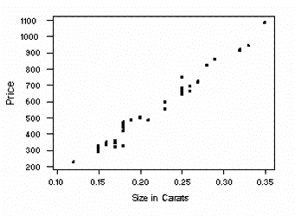
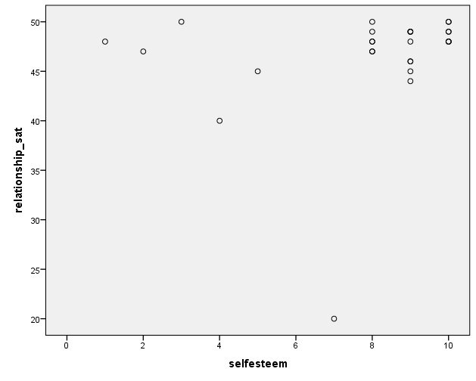
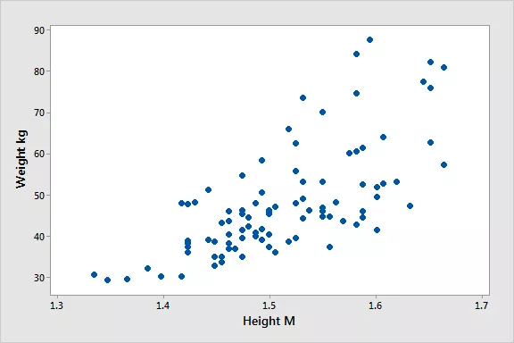
Scatterplots

Slide 8
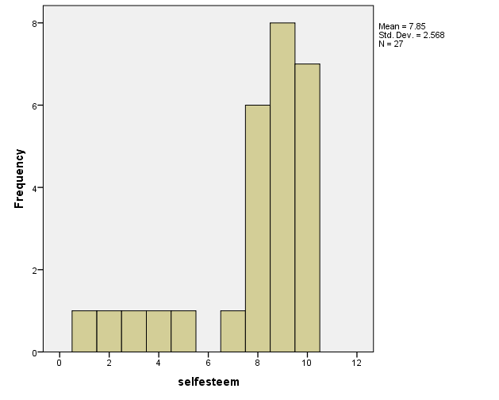
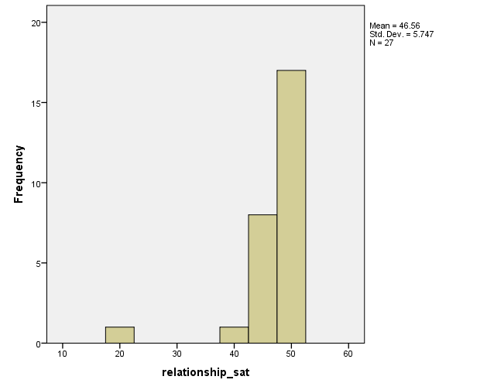
3 things that can bias correlations
Truncated range
Outliers
Small n

Slide 9
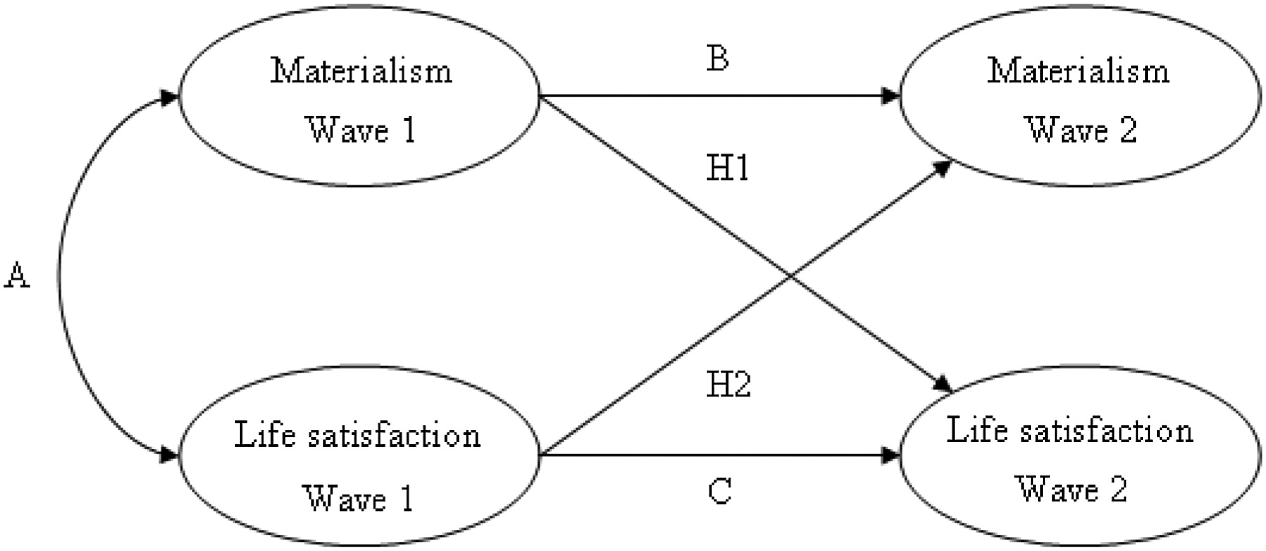
Cross-lagged correlations
Opree, Buijzen, & Valkenburg, 2012

Slide 10
Excel demo
Adding a constant doesn’t affect the correlation
Reducing the range does
Having an outlier does

Slide 11
How to interpret correlations
Correlation between and height: .50
Participants who were older tended to be taller.
Correlation between age and weight: -.34
Participants who were older tended to weigh less.

