Slide 1
Issues with Surveys

Slide 2
Issues with surveys
Question wording
Question order
Question type
Response type/order

Slide 3
Question wording example
Jan 2003, Pew Research Center survey
Do you favor or oppose taking military action in Iraq to end Saddam Hussein’s rule? 68% favored, 25% opposed
Do you favor or oppose taking military action in Iraq to end Saddam Hussein’s rule even if it meant that U.S. forces might suffer thousands of casualties? 43% favored, 49% opposed

Slide 4
Find the problem
How likely are you to vote for Proposition 47?
I eat a lot of carbs.
Atheists should not be allowed to adopt children.
I intend to eat less meat in the next month.
Do you agree that parking is a problem on campus?
If I saw someone who was hurt and I was in a hurry, I’d probably just walk on by.

Slide 5
Find the problem
When did you move to Cedar Falls?
On days when you drink alcohol, how many drinks do you usually have?
I feel completely secure in facing unknown new situations because I know that my partner will never let me down.
How long have you been married?
I feel I do not have much to be proud of.
I exercise 3 times per week.

Slide 6
Summary of wording issues
AVOID:
Negative statements (confusing)
Double barrel items
Items where “agree” could mean more than one thing
Items affected by social desirability
Items people wouldn’t know or can’t answer
Charged words

Slide 7
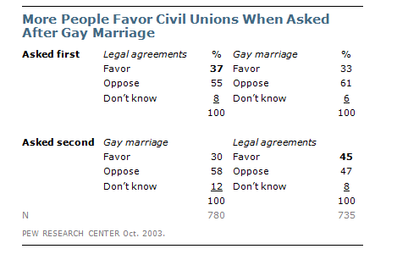
Question order example

Slide 8
Find the problem
Asking about marital satisfaction and then life satisfaction
Asking about whether Democrats should do more to work with Republicans and then the opposite

Slide 9
Question order summary
Item-order effect
Contrast vs. assimilation effects
To fix:
Randomize or counterbalance order
Ask general and then specific

Slide 10
Question type
Open-ended vs. close-ended
Rating scale

Slide 11
Question type example
What one issue mattered most to you in deciding how you voted for President? (2008 election)
Open-ended: 35% said economy
Close-ended (1 of 5 options, plus other): 58%
Open-ended: 43% mentioned something not included in options
Close-ended: only 8% did

Slide 12
Response option example
How often do you exercise?
Infrequently 17%
Occasionally 48%
Often 35%
In the last six months, how often have you engaged in at least 20 minutes of aerobic activity?
Almost never 17% 3x/week 15%
Less than 1x/week 13% 4x/week 15%
1x/week 12% >4x/week 13%
2x/week 15%

Slide 13
Find the problem
My electric bill is usually
Less than $50/month
$50-100/month
$100-200/month
$200-500/month
How do you think the President is doing?
Okay
Good
Great
Amazing!

Slide 14
Find the problem
What is the ideal number of lifetime sexual partners?
0 1-5
1 6-10
2 11-15
More than 2 more than 15

Slide 15
Response option summary
Recency effect: On phone tend to choose last
Primacy effect: In print, tend to choose first
If they aren’t continuous (e.g., strongly disagree to strongly agree), then randomize the order
Make sure all options are available and clear and seem socially desirable

Slide 16
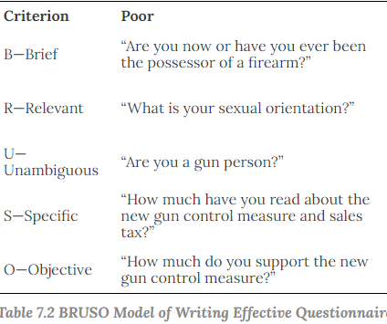
Keep items BRUSCO
Brief (few words as possible)
Relevant (don’t ask if you don’t need to)
Unambiguous (make sure item is clearly understood)
Specific (asks a specific thing clearly)
Objective (not leading)

