Slide 1
Types of observation

Slide 2
Types of observational studies
Naturalistic observation
Disguised
Undisguised

Slide 3
Types of observation
Participant observation
Covert (disguised)
Overt (undisguised)

Slide 4
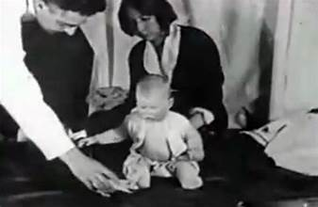
More types of observation
Systematic observation
Case studies
Deviant case analysis
Archival research
Content analysis

Slide 5
Write the best observational method (and a short description of how you would do the study with specific suggested measures) for each study.
1. You’re interested in studying how many students read the Northern Iowan.
2. You’re interested in the causes of obsessive compulsive disorder in a client you’ve been seeing for two years.
3. You want to learn how fraternities affect university socialization.
4. You are interested in the matching hypothesis of attraction (that people generally choose partners that are at about the same level of attractiveness as themselves).
5. You want to study how cult leaders induce people to follow them.
6. You want to study the causes of alcoholism. You have two twins available to observe—one is an alcoholic and one isn’t.

Slide 6
Steps in structured observation
Find an observable measure
Select setting and mode of observation
Select sampling strategy
Train the observers
Inter-rater reliability
Analyze the data

Slide 7
Do a structured observation

