Slide 1
Measurement and Scale Creation

Slide 2
Are these good operational definitions?
Skull size as a measure of intelligence
2D/4D finger ratio as a measure of prenatal testosterone
Number of times a couple had sex last week minus number of arguments last week as a measure of marital satisfaction
Circumference of flexed bicep muscle of dominant hand as a measure of fighting ability
Heart rate as a measure of cognitive dissonance

Slide 3
Construct
Conceptual definition
Operational definition

Slide 4
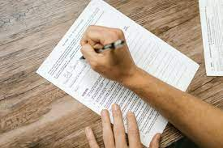
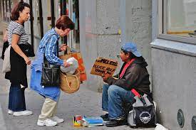
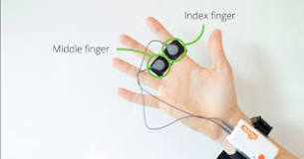
What types of measures do we use in psych?
Self-report
Behavioral
Physiological

Slide 5
Survey (method)
Scale
(measures one construct)
Questionnaire
(set of questions or scales)

Slide 6
Steps to creating a measure

Slide 7
Step 1: Pick what you’ll measure
Come up with a unidimensional construct to create a scale about
Personality trait: Generosity, Shyness, Extraversion, etc. OR
Attitude: Belief in climate change, Attitudes about a helmet law for cyclists, etc.
Unidimensional: One specific construct
NOT: attitudes toward UNI because that could be about the administration, sports teams, professors, etc.
But maybe: Attitudes about parking on campus
Or do a multidimensional scale and identify subscales

Slide 8
Step 2: Decide what response scale you’ll use
5-7 options
Examples here: https://www.marquette.edu/student-affairs/assessment-likert-scales.php
Most common:
Strongly disagree to strongly agree
Never to always
Not at all like me to very true of me
Better if you label each choice

Slide 9
Step 3: Come up with items
Bad questionnaire item examples
Identify the problems

Slide 10
Avoid these in your items:
Double negatives
Double barrel (2 thoughts)
Mean more than one thing
Social desirability issues
People might not easily know
People might not be able to answer
Biased wording
Words or phrases people might not know

Slide 11
Reverse score some items
Have some items that are positively worded and some that if you agree, mean the opposite.
I like to go to loud parties.
I like to be alone most of the time.
But try not to use not

Slide 12
Step 4: Narrow down your items
Step 5: Test your scale psychometrics
Item understanding
Item variability
Reliability
Validity

Slide 13
Questionnaire order
Consent
Measures (think about the order)
Demographics
Debriefing

