Slide 1
Reliability and validity

Slide 2
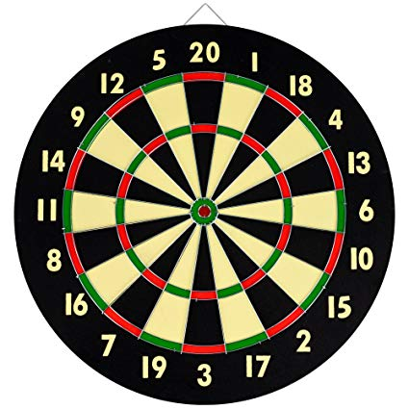
Reliability
Consistency
Validity
Truth
True score + measurement error
Can a scale be reliable but not valid?
Can a scale be valid but not reliable?

Slide 3
Types of reliability
Across time
Test-retest
Alternate forms
Across items (internal consistency)
Split half
Odd even
Across observers
Inter-rater reliability
Cronbach’s alpha

Slide 4
Construct validity
Face
Content
Criterion-related
Concurrent
Predictive
Convergent
Divergent
Known groups

Slide 5
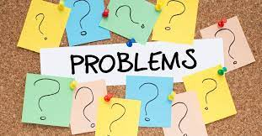
Problems for Construct validity
Demand characteristics
Social desirability

Slide 6
Other types of validity
Construct
Internal
Statistical conclusion
External

Slide 7
Headline problems
https://m.youtube.com/watch?fbclid=IwAR1EhqP52xASSP0foWmDeioieS8br6uOPs9CniJKz_fJCgFtwPy0mYGpXf4&v=w1CeRpfByG8&feature=youtu.be
What types of validity do these issues get at?

