Slide 1
“Replication crisis”
or Psychology’s Renaissance

Slide 2
Think-Pair-Share
Had you heard of the replication crisis before? If so, what did you hear? Had you heard of ego depletion?
What do you think of the replication crisis? Is it a problem? Explain.
What does it mean (for society, knowledge, etc.) if science is sometimes wrong?

Slide 3
Not just a problem in psychology
Only 11%-25% of drug studies replicated in private labs.
Only 59% of highly cited clinical research studies replicated.
Only 29% of cancer biology studies.
Only 44% of associations replicated in genetic studies.
Only 25-63% of studies replicated in economics (some using the same data!)
Only 39% subjectively rated as replicated in psychology, and 54% in the very top journals.
Prinz, Schlange, & Asadullah, 2011; Begley, & Ellis, 2012; Ioanndis, 2005; Lohmueller, Pearce, Pike, Lander, & Hirschhorn, 2003; Dewald, Thursby, & Anderson, 1986; Chang & Li, 2015; Open Science Collaboration, 2015; Klein et al., 2018; Errington, Iorns, Gunn, Fraser, Lomax, & Nosek, 2014.

Slide 4
What does it mean if a study doesn’t replicate?
First study
Second study
Both (hidden moderators)

Slide 5
Types of replication
Direct
(exactly the same)
Conceptual (different operational defs)

Slide 6
Scientific method
Generate hypothesis
Design study
Collect data
Analyze and interpret data
Publish findings

Slide 7
The problem?

Slide 8
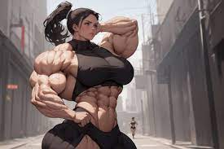
Replication crisis/Credibility crisis/Scientific Renaissance causes
Questionable research practices (QRPs) aka researcher degrees of freedom
File drawer problem/publication bias
p-hacking
HARKing
Small sample sizes
System pressures and incentives
Fraud
Moderator effects
Fraud

Slide 9
Media coverage contributions
Headline sounds certain (science is cumulative—1 study isn’t enough)
Don’t give method details (needed to understand)
Overgeneralize (science is probabilistic)
Corrections don’t get as much attention

Slide 10
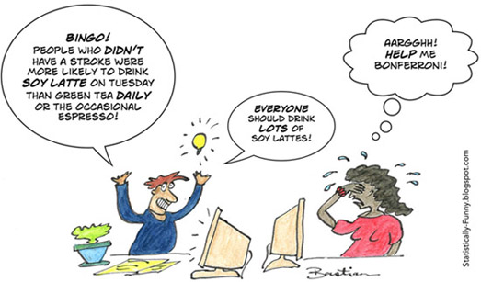

Slide 11
Scientific method
Generate hypothesis
Design study
Collect data
Analyze and interpret data
Publish findings
Lack of replications
HARKing
Publication bias
Selective reporting
Low powered designs/small samples
p-hacking

Slide 12
How common are these behaviors?
Meta-analysis of surveys of scientists in various fields
72% | 34% | 14% | 2%
Have seen colleagues doing QRPs | Say they’ve done QRPs | Have seen colleagues committing fraud | Say they’ve committed fraud
Fanelli, D. (2009). How many scientists fabricate and falsify research? A systematic review
and meta-analysis of survey data. PLoS One, 4, e5738.

Slide 13
Psychology looks even worse (depending on who and how you ask)
 | John et al., 2012 | Fiedler & Schwarz, 2016 | Motyl et al., 2017
Done QRPs at least once | 13-78% | 4-48% | 3-63%
Falsified data | 9% | 4% | 1%

Slide 14
Harton, Alacha, Barton, Meehan, Garner, Karuni, & Reyes, 2020
Self-reported Frequency of Behavior | Psychology | Economics | Pol Sci | Effect size (η²)
Not report all measures or analyses | 2.41_{ab} | 2.79_{b} | 2.26_{a} | .026*
Collect data on multiple DVs | 2.04 | 2.20 | 2.10 | .003
Selectively report studies | 1.79 | 1.49 | 1.63 | .016
Peeking at data | 1.69 | 1.84 | 1.72 | .003
HARK | 1.61 | 1.53 | 1.58 | .001
Not report all IVs | 1.44_{a} | 1.84_{b} | 1.58_{ab} | .029*
Exclude data based on effects | 1.42_{a} | 1.75_{b} | 1.46_{a} | .031
Round p-value | 1.16 | 1.16 | 1.20 | .001
Stop collection early | 1.13 | 1.18 | 1.19 | .004
Claim no effect without checking | 1.20 | 1.06 | 1.18 | .011
Falsify data | 1.00 | 1.02 | 1.00 | .016

Slide 15
Harton, 2019
Likelihood of QRPs
Demographic factors:
Gender
Year of PhD
Age
Institutional factors:
Type of school
Department
Experience factors:
IRB experience (# protocols)
Internal factors:
Anticipated shame
Perceived harm
Moral judgment
Acceptability
Peer behavior
External factors:
Moral judgment matters more when sanctions are low (sometimes)

Slide 16
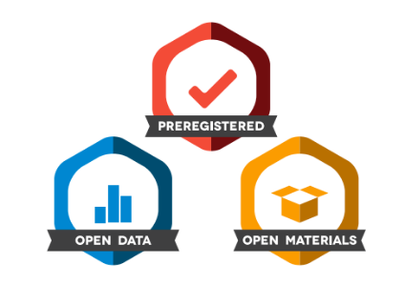
How is psychology/science improving to fix these issues?
Pre-registration
Open data
Open materials
Encourage more replication studies
Registered reports
Use bigger sample sizes
Change incentives
Open Science Framework

Slide 17
https://twitter.com/BrianNosek/status/1107627577739481088/photo/1 (Miguel & Paluck study; rep sample in soc/beh sci)

Slide 18
Harton, Alacha, Barton, Meehan, Garner, Karuni, & Reyes, 2020
Self-reported Frequency of Behavior | Psychology | Economics | Pol Sci | Effect size (η²)
Report effect sizes | 3.89_{a} | 3.35_{ab} | 3.25_{b} | .045**
Conduct a priori power analysis | 3.10 | 2.81 | 2.86 | .008
Made data public | 2.21_{b} | 3.02_{a} | 3.31_{a} | .117**
Pre-register | 1.79_{a} | 1.36_{b} | 1.51_{ab} | .033*

Slide 19
Case Study 1: Wearing red makes you look hotter

Slide 20
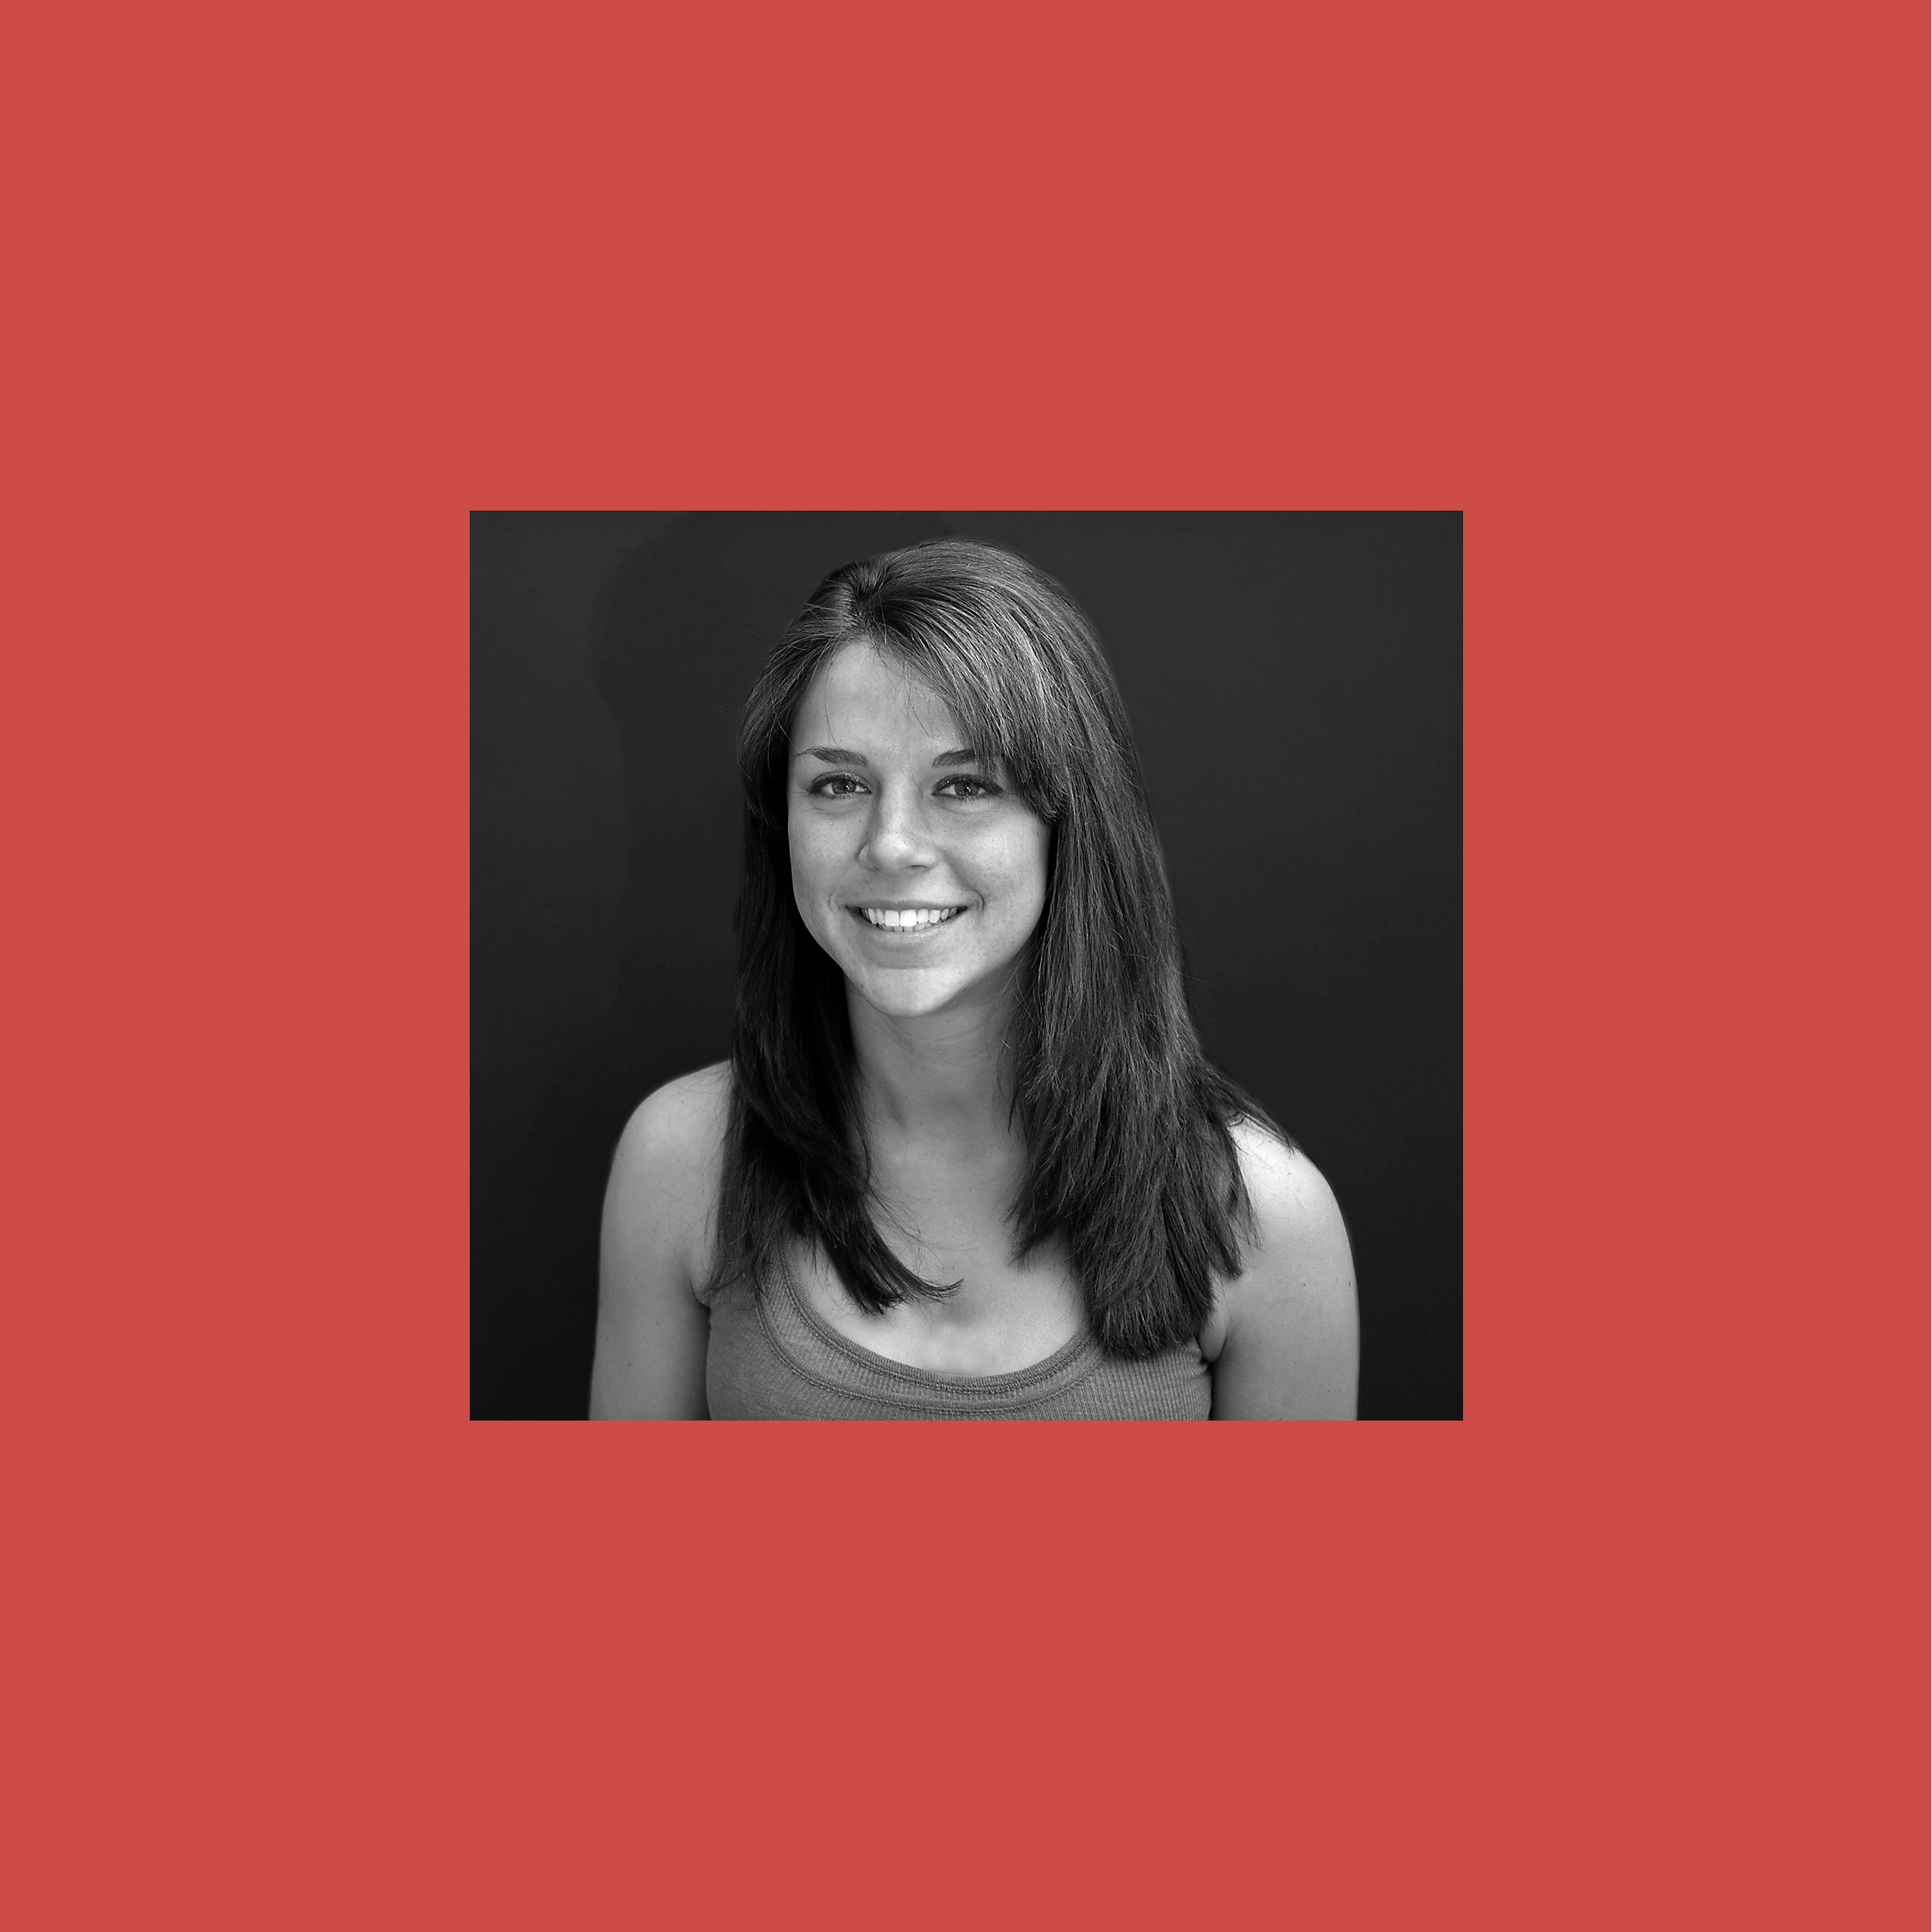
How attractive/pretty do you think this person is? (1-9 scale)

Slide 21
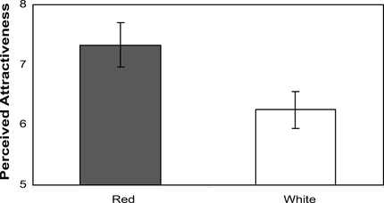
Perceived attractiveness as a function of color in Experiment 1. Confidence intervals (95%) are indicated by vertical lines.
Elliot, A. J., & Niesta, D. (2008). Romantic red: Red enhances men's attraction to women. Journal of Personality and Social Psychology, 95(5), 1150-1164. doi:10.1037/0022-3514.95.5.1150
© 2008 American Psychological Association

Slide 22
Romantic red
Gueguen, 2010—Female hitchhikers wearing red t-shirts are picked up more often by men
Kramer & Mulgrew, 2018—men and women wear red (and black) more often on dates on a tv show “First Dates”
Are these direct or conceptual replications? Why does that matter?

Slide 23
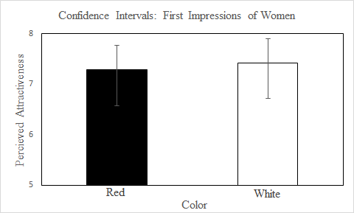
Zubrod, Washburn, Pieper, Lewey, & Harton, 2018
Figure 1. Perceived attractiveness as a function of color in our partial replication using the same x- and y-axes as Elliot and Niesta (2008, p. 1153). The vertical lines represent 95 % confidence intervals

Slide 24
Other studies also haven’t always replicated the finding
Peperkoorn, Roberts, & Pollet, 2016
3 studies
No effect, including 1 direct replication
Lehmann & Calin-Jageman, 2017
Extremely small effects with direct replication, and in opposite direction for women rating men
Meta-analysis by Lehmann, Elliott, & Calin-Jageman, 2018
41 studies
Over 2000 participants
Overall d = .26 (CI .12, .40) for men rating women
Overall d = .13 (CI .01 to .25) for women rating men

Slide 25
Case study 2: Thinking about older adults makes you slow down

Slide 26
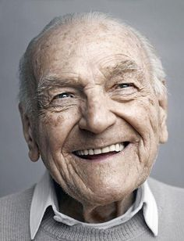
Bargh, Chen, & Burrows, 1996 (Study 2)
https://www.youtube.com/watch?v=5g4_v4JStOU
When you’re primed with “old people” words, you walk more slowly.
Florida, old, lonely, grey, retired, bingo
Bargh, J. A., Chen, M., & Burrows, L. (1996). Automaticity of social behavior: Direct effects of
trait construct and stereotype-activation on action. Journal of Personality and Social Psychology,
71, 230-244.

Slide 27
Doyen replication, 2012
You only get the effects if you tell the experimenter that the person is supposed to walk slowly.
Doyen, S., Klein, O., Pichon, C., & Cleeremans, A (2012).
Behavioral priming: It’s all in the mind, but whose mind? PLoS One,
7, e29081.

Slide 28
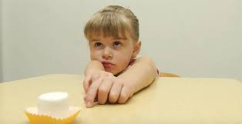
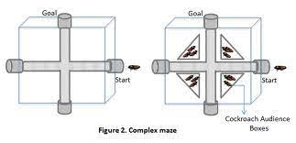
Other replications (or not)
Marshmallows and back again
Ego depletion
Cockroaches
Bystander intervention
Power posing
Stereotype threat
Priming

Slide 29
Graphic version of this
https://thenib.com/repeat-after-me/

